Slide 1
Bea Nemeth
14 January 2022
e-mail: bea.nemeth@yahoo.co.uk
Tel: +36204300732
https://github.com/green-fox-academy/beanemeth
Picking the best outfit
for a photoshoot

Slide 2
The Task
You have to attend a family Christmas photoshoot, and you have carefully selected your children’s outfit, but forgot to pick one for yourself. Thankfully, your husband is still at home. Ask him to bring you a dress that goes with the photoshoot’s backdrop by telling him a few keywords.
Caption

Slide 3
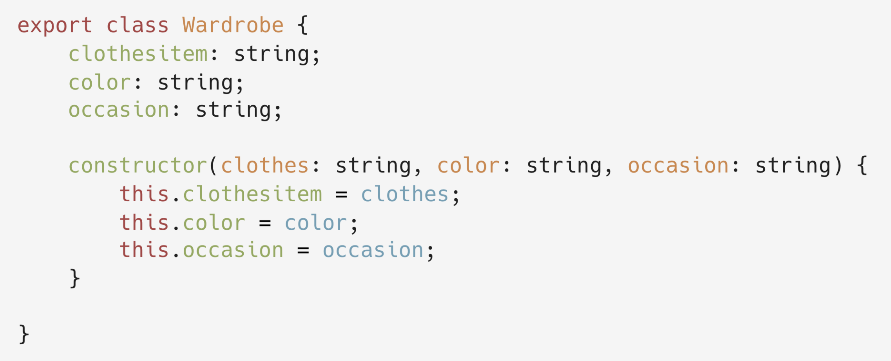
Solving the problem in three steps
Step 1: Create a class and constructor

Slide 4
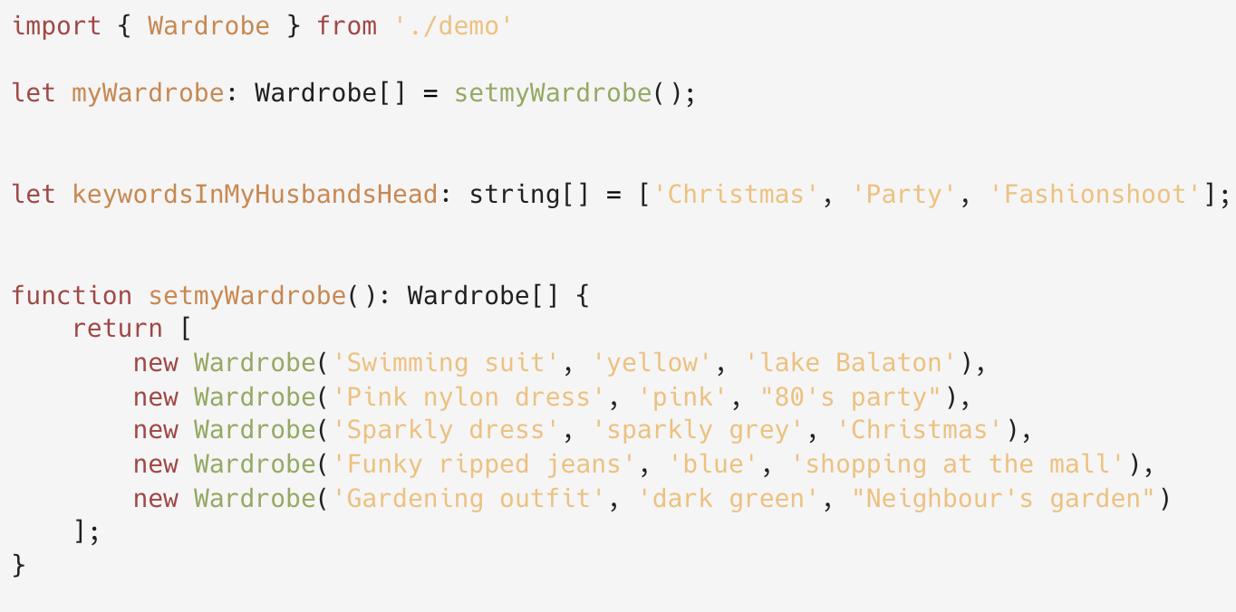
Step 2:
Create a few instances and
a keyword string array to work with

Slide 5
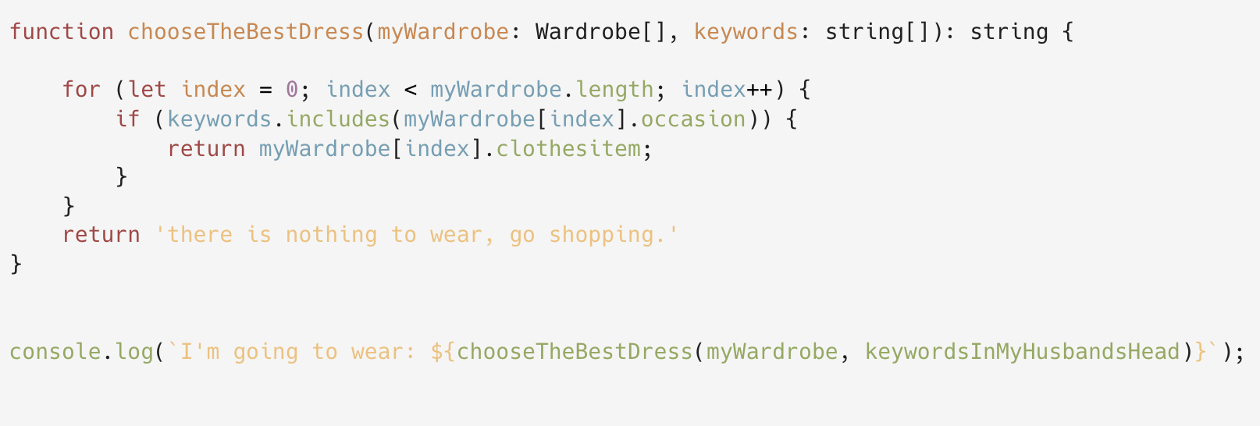
Last step:
Write a method

Slide 6

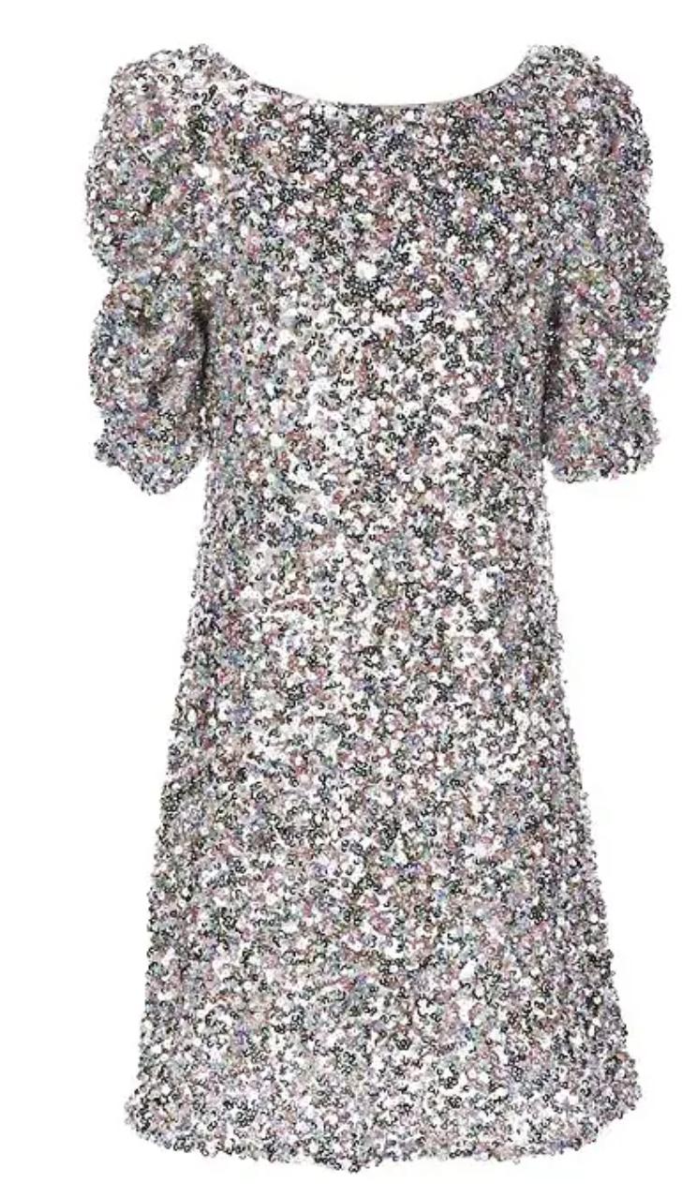
Here it goes!

Slide 7

Thank you very much for your kind attention!

